Slide 1



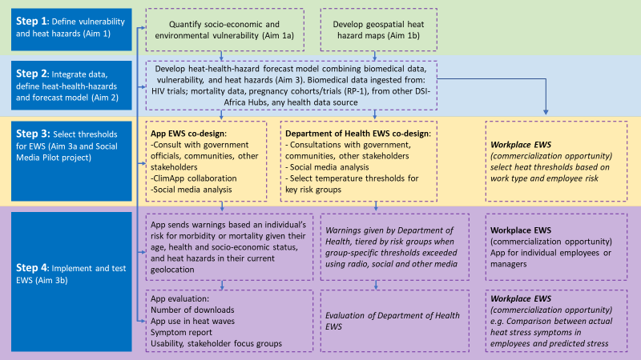
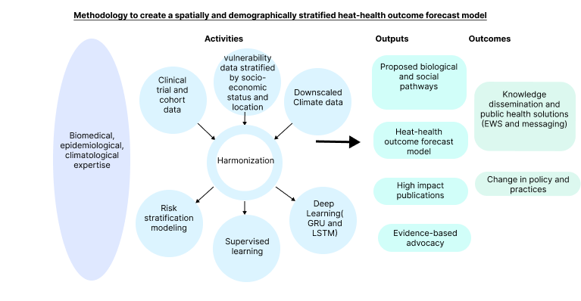
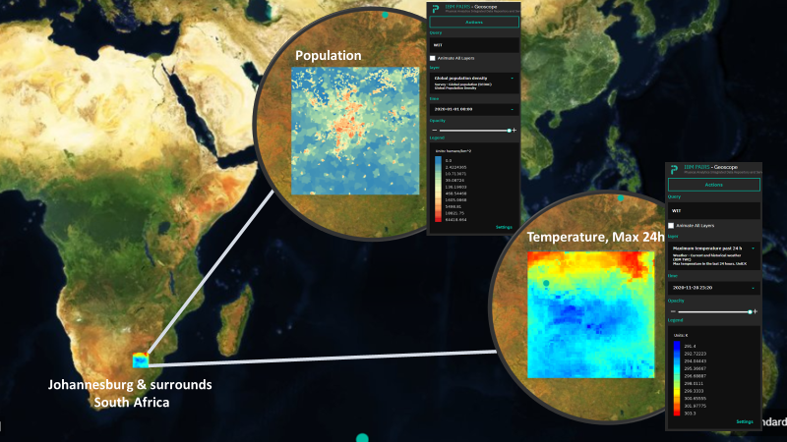







Innovative machine learning and multi-source data analysis toward the development of an urban heat-health Early Warning System in two African cities
A protocol of a multi-source secondary data analysis
Authors: Authors: Chris Jack, Craig Parker, Yao Etienne Kouakou, Bonnie Joubert, Kimberly McAllister, Maliah Ilias, Matthew Chersich, Sibusisiwe Makhanya, Stanley Luchters, Etienne Vos, Kristie Ebi, on behalf of the HE2AT Center
Background
Aim 2
Temperature increases in the past and projected increases in the future have intersected with rapid urban growth, significant levels of informality, and increasingly overburdened health services, creating a critical intersection between climate change and African city development patterns. High average temperatures are a leading cause of illness and death in cities. Temperature impacts the severity and distribution of health consequences, but so do location, topography, society, and the environment. It is critical to have a firm grasp of this complexity to create solutions considering urban areas’ spatial and demographic diversity. This study protocol describes the HEAT center’s second project, where multi-source data will be analyzed using data science and machine learning methods to uncover previously unknown interactions between biological and climate mechanisms.
Aim 2 is to create a spatially and demographically explicit heat-health outcome model that will allow researchers to predict the likelihood of adverse health outcomes days or weeks before storms and droughts occur
The model will predict the likelihood of adverse health outcomes at different temperatures.
The strongest predictor variables from a suite of socio-economic variables at each geographic location will be determined using machine learning models.
Biological health effects to be investigated include, but are not limited to, hypertension, respiratory stress, cardiac conditions, inflammation, and renal disease.
Deep learning.
The model will predict the likelihood of adverse health outcomes at different temperatures.
The strongest predictor variables from a suite of socio-economic variables at each geographic location will be determined using machine learning models. Biological health effects to be investigated include, but are not limited to, hypertension, respiratory stress, cardiac conditions, inflammation, and renal disease.
Methods and analysis
The research will take place in Abidjan, Ivory Coast, and Johannesburg, South Africa. We will combine and analyze a wide range of non-traditional health data sources using predictive analytics and data science techniques such as natural language processing and geospatial analysis. We will develop existing image processing approaches, particularly dimensionality reduction, on available satellite imagery to further classify street density and layouts to create maps of urban typology, including estimates of building types, densities, and green areas. We will combine data from recently developed high-resolution climate models with available meteorological station observations such as community observations, temperature variations with altitude, and land surface maps to create high-resolution vulnerability-hazard maps for each city under varying large-scale weather conditions. Following the creation of vulnerability-hazard maps, information on health outcomes will be superimposed on top using a variety of data sets. Quantile Regression Forests and Gated recurrent unit models will be used to develop statistical models of heat-health outcomes using data from large health trials in Johannesburg, where participants’ residences are known, and fine-resolution geospatial mapping is possible. It will then be adjusted based on data gathered in Abidjan.
Figure 2: oditata tibust, odi cullatu repudipsum
Aim 3
Aim3 is to create an early warning system based on the heat-health outcome forecast model, including a digital app. These warnings are the pivot of the healthcare system’s response during a heat wave. They initiate a series of interventions to reduce health risks and prepare the health system for increased heat-related illnesses.
Way forward
Data acquisition will be the dominant focus over the upcoming months with clinical and cohort data being requested from….
Aims 1
The first goal is to create an index of African cities’ intra-urban socio-economic and environmental vulnerability. This entails using machine learning methods to investigate variables such as housing types, land use, elevation, and building types. The coarse-scale weather and seasonal forecast model features create high-resolution urban temperature hazard maps
Research reported in this publication was supported by the Fogarty International Center and National Institute of Environmental Health Sciences (NIEHS) and OD/Office of Strategic Coordination (OSC) of the National Institutes of Health under Award Number U54 TW 012083. The content is solely the responsibility of the authors and does not necessarily represent the official views of the National Institutes of Health.
AuthorAffiliations
1. Climate System Analysis Group, University of Cape Town
2. Wits Reproductive Health and HIV Institute (Wits RHI), University of the Witwatersrand, Johannesburg
3. University Peleforo Gon Coulibaly, Abidjan
4. IBM Research Africa, Johannesburg
5. Centre for Sexual Health and HIV & AIDS Research, Harare
Corresponding Author:
Dr. Chris Jack Email: cjack@csag.uct.ac.za
Website: www.wrhi.ac.za
Figure 1: oditata tibust, odi cullatu repudipsum

